Slide 1
SMTP Configuration on Informatica Version 10.2.0 HotFix1 Build: 417 - Aug 3, 2018
Author:Janakiram Meka

Slide 2
SMTP configuration Unix
SMTP configuration is not supported on UNIX operating systems. Informatica uses sendmail to send email notification which needs to set operating system level.
Local host relay is disabled due to vulnerabilities or organization policies.
telnet localhost 25
Trying ::1...
telnet: connect to address ::1: Connection refused
Trying 127.0.0.1...
telnet: Unable to connect to remote host: Connection refused
Sendmail needs to be installed
which sendmail
/usr/sbin/sendmail
SMTP host needs to be updated on the operating system level.
cat /etc/mail/submit.cf|grep DS
DSmail.xxxx.com
# Return-Receipt-To: header implies DSN request
# DHParameters (only required if DSA/DH is used)
sendmail uses submit.cf to run in mail submission program (MSP) mode, which submits email messages and can be invoked by programs (such as mailx), as well as by users

Slide 3
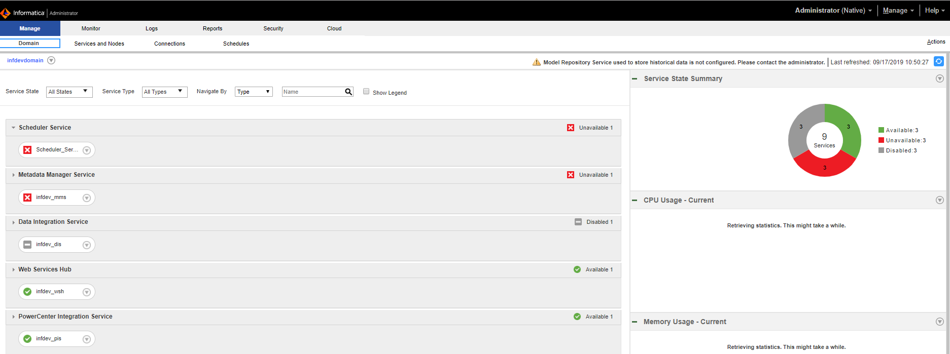
SMTP configuration windows
Login to informatica administration console

Slide 4
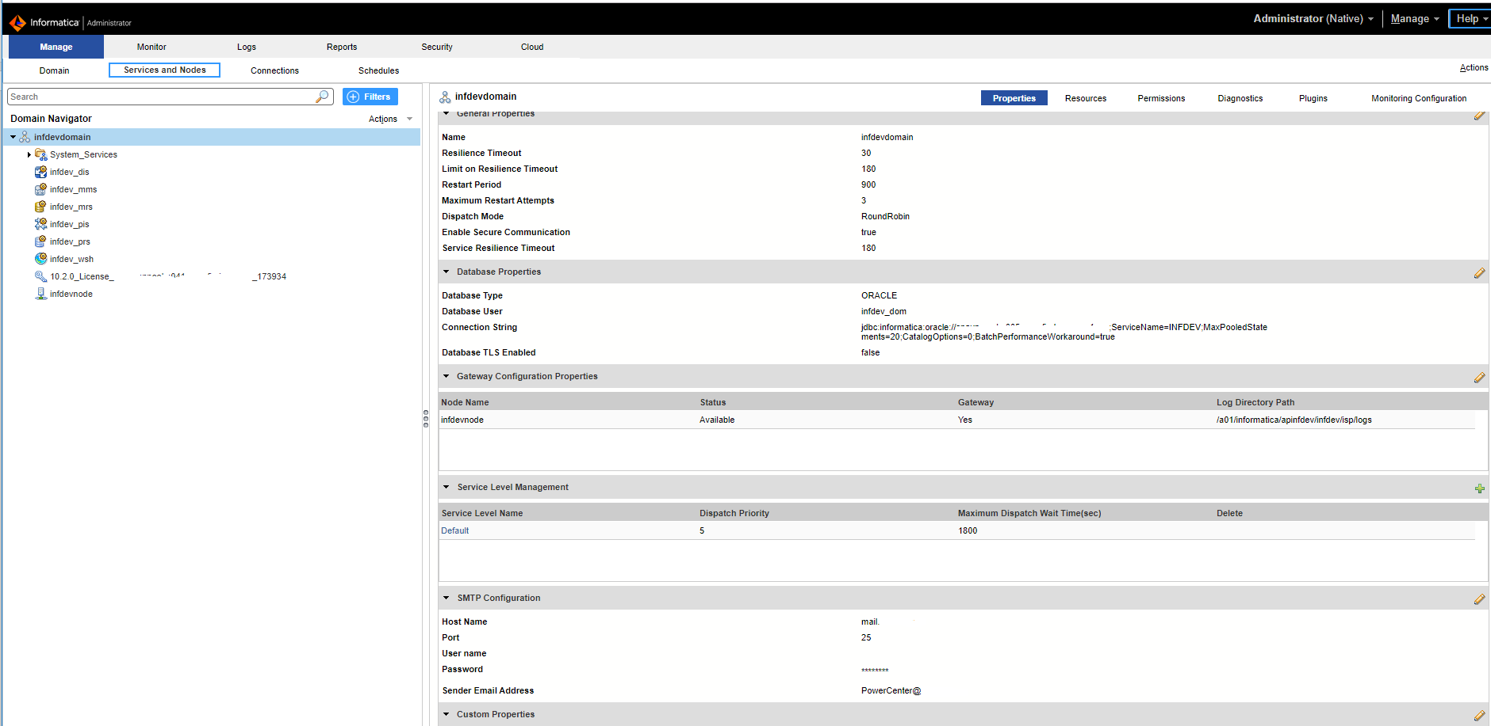
SMTP configuration windows
Navigate to service and nodes and select domain and update smtp details.

Slide 5
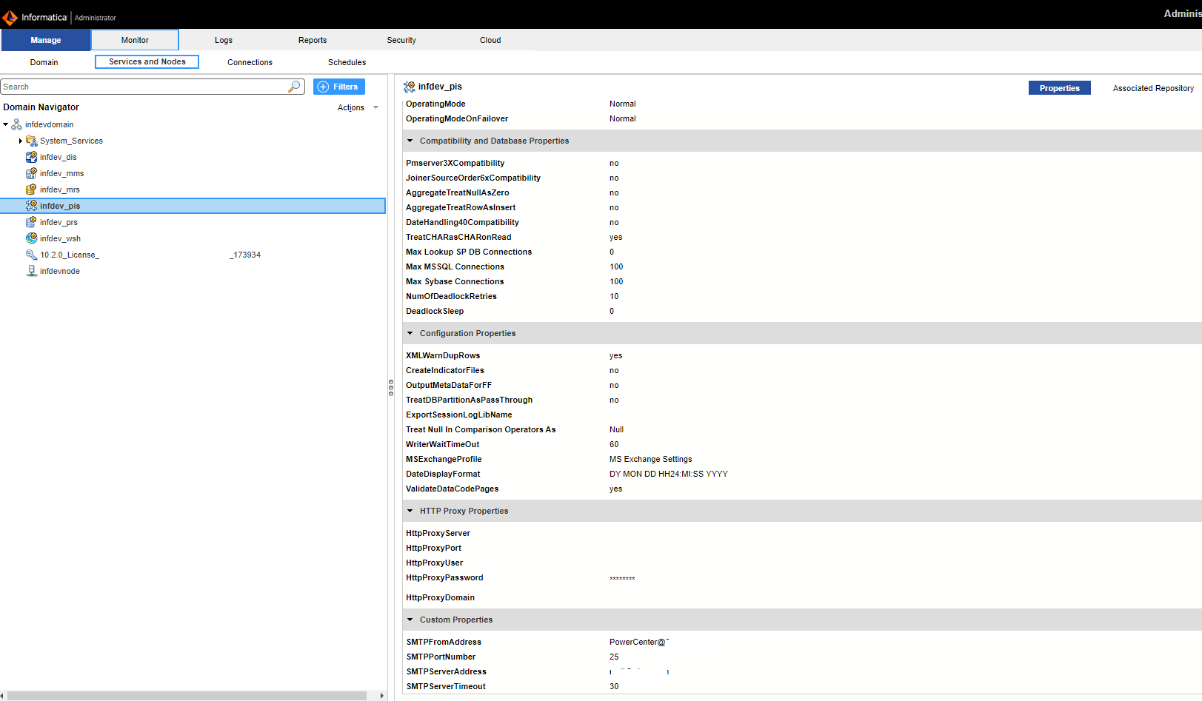
SMTP configuration windows
Navigate to power center integration service and update with custom properties for SMTP

Slide 6
SMTP configuration windows
Bounce integration service if doesn’t work bounce complete domain to reflect changes.

Slide 7
SMTP Configuration on Informatica Version 10.2.0 HotFix1 Build: 417 - Aug 3, 2018
References: Informatica support and administrator guide.

