Slide 1
HFM Data Refresh
Author: Janakiram Meka

Slide 2
Steps involved
Export HFM application schema from Source(Production) environment
Create new Table space in Target or Use existing tablespace
Import HFM application schema to Target environment
Create Database link in target
Cleanup application if refreshing existing Application.
Import Application from Consolidation Administration
Import Security of HFM application from Source to Target using LCM
Restart the HFM server services

Slide 3
Export HFM application schema from Source(Production) environment
expdp schemas=EPM_HFM directory=DATA_PUMP_DIR dumpfile=EPM_HFM_CLOUD_072319.dmp logfile=EPM_HFM_CLOUD_072319.log

Slide 4
Create new Table space in Target or Use existing tablespace
create tablespace epm_hfm_cloud_data datafile '/d02/oracle/epmdevdata/epmdev/epm_hfm_cloud_data01.dbf' size 1800m autoextend on next 100m maxsize 20480m;
alter tablespace epm_hfm_cloud_data add datafile '/d02/oracle/epmdevdata/epmdev/epm_hfm_cloud_data02.dbf' size 1800m autoextend on next 100m maxsize 20480m;
alter tablespace epm_hfm_cloud_data add datafile '/d02/oracle/epmdevdata/epmdev/epm_hfm_cloud_data03.dbf' size 1800m autoextend on next 100m maxsize 20480m;

Slide 5
Import HFM application schema to target environment
CREATE OR REPLACE DIRECTORY DUMPDIR AS '/d03/oracle/hypdevdata/temp_dump';
GRANT READ, WRITE ON DIRECTORY DUMPDIR TO system;
impdp system/xxx directory=DUMPDIR dumpfile=EPM_HFM_072519.dmp logfile=epm_hfm_cloud.log remap_schema=EPM_HFM:epm_hfm_cloud remap_tablespace=epm_hfm_data:epm_hfm_cloud_data

Slide 6
Create Database link in target
GRANT CREATE DATABASE LINK TO epm_hfm;
SQL> conn epm_hfm/xxxxx
Connected.
SQL> CREATE DATABASE LINK epm_hfm_uat_link CONNECT TO epm_hfm_uat IDENTIFIED BY Tr1ckAp2 USING ‘//server:port/sid';

Slide 7
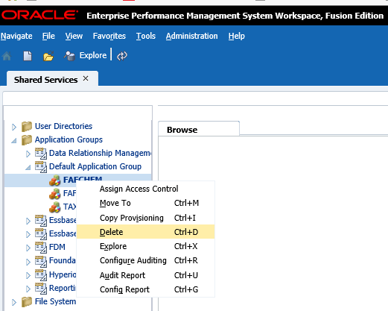
Cleanup application if refreshing existing Application.
Delete application from shared services and drop tables and datasource
select * from all_objects where owner='EPM_HFM' and object_name like '%FAFCHFM%' and object_type='TABLE’;
SELECT 'DROP TABLE ' ||owner||'.'|| object_name || ' CASCADE CONSTRAINTS;' from all_objects where owner='EPM_HFM' and object_name like '%FAFCHFM%' and object_type='TABLE’;
SELECT 'DROP PACKAGE ' ||owner||'.'|| object_name || ' ;' from all_objects where owner='EPM_HFM' and object_name like '%FAFCHFM%' and object_type='PACKAGE'
select * from EPM_HFM.HSX_DATASOURCES
delete from EPM_HFM.HSX_DATASOURCES where APPNAME='FAFCHFM' and DESCRIPTION='FAFCHFM'

Slide 8
Import Application
Log on to the destination EPM system.
Select Navigate, then Administer, and then Consolidation Administration
Select Administration, and then Import Applications.
Select Database Link if you are importing between Oracle databases, or select Linked Server if you are importing between SQL Server databases.
When you select Database Link or Linked Server, the source applications are listed.
From the application list, select the source application.
Specify the Destination Application Name and Destination Application Description.
The source application is imported with this name and description.
For Cluster, select the cluster the application should be registered on.
For User Management Project, select the project the application should be registered on.
Optional: Select the Import Audit Tables option to import the Data Audit and Task Audit tables from the source to the destination application.
Optional: Select the Import Data Tables option to import the data tables from the source to the destination application.
If you select Import Data Tables, you must also specify the Scenario and Year filters.
Click Import.

Slide 9
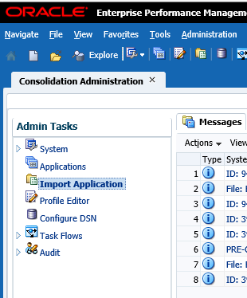
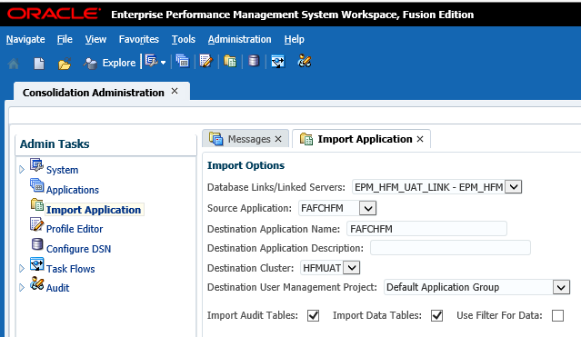
Import Application (Cont.)

Slide 10
Import Security of HFM application from source to target using shared service
Log on to the source EPM system.
Select Navigate, then Administer, and then shared services console
Select foundation and browse to Shared services
Click on Native Directory -->assigned roles-->Application group-->click application and export
Log on to the target EPM system
Upload file to file system
Import the security

Slide 11
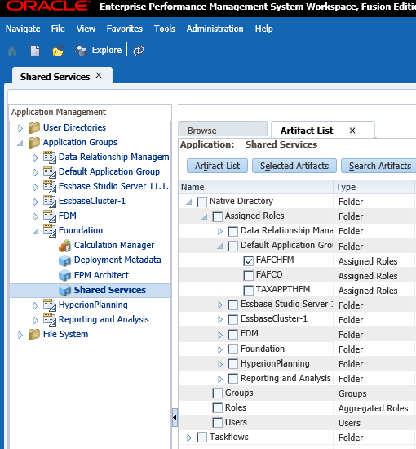
Import Security of HFM application from source to target using shared service (Cont.)

Slide 12
Restart the HFM server services

Slide 13
References
https://docs.oracle.com/cd/E57185_01/HFMAG/ch02s16.html
Hyperion Financial Management 11.1.2.4 Application Copy using HFM Copy App Utility (Doc ID 2099228.1)

